Slide 1
Animal Species Synthesis with Generative Adversarial Networks (GANs)
PRESENTED BY: KIRUTHIKA LAKSHMI.D
REGISTER NO:813821205024
DEPARTMENT:INFORMATION TECHNOLOGY
COLLEGE:SARANATHAN COLLEGE OF ENGINEERING
3/21/2024 Annual Review

Slide 2
PROJECT TITLE
Animal Species Synthesis with Generative Adversarial Networks (GANs)
3/21/2024 Annual Review

Slide 3


AGENDA
Introduction
Problem Statement
Project Overview
End Users
Solution and Value Proposition
Key Features
Modelling: Understanding Convolutional Neural Networks (CNN)
Results
Conclusion
3/21/2024 Annual Review

Slide 4

PROBLEM STATEMENT
This project aims to utilize Generative Adversarial Networks (GANs) to generate realistic images of animal species. The GAN framework consists of a generator and a discriminator neural network. The generator learns to produce synthetic animal images from random noise, while the discriminator learns to distinguish between real and generated images. Through training, the generator aims to create increasingly lifelike images to deceive the discriminator, which in turn improves
its ability to discriminate. The project involves
training the GAN model on a dataset of animal images
and exploring techniques to enhance image quality
and stability.The goal is to create a GAN model capable
of generating convincing animal images.
3/21/2024 Annual Review

Slide 5

PROJECT OVERVIEW
Our project aims to utilize Generative Adversarial Networks (GANs) to generate synthetic images of animal species. GANs are a class of deep learning models that consist of two neural networks, a generator and a discriminator, trained simultaneously to produce high-quality synthetic data. By training a GAN on a dataset of animal images, we can generate new and diverse images of animal species.
3/21/2024 Annual Review

Slide 6

WHO ARE THE END USERS?
Artists and designers looking for inspiration or references for their artwork.
Game developers needing a large variety of animal images for character design and world-building.
Researchers and students studying computer vision and generative models.
Companies involved in data augmentation for machine learning applications such as image classification and object detection.
3/21/2024 Annual Review

Slide 7

YOUR SOLUTION AND ITS VALUE PROPOSITION
Our solution involves training a GAN on a dataset of animal images to generate synthetic images of various animal species. This approach offers the following value propositions:
Provides a time-efficient and cost-effective way to generate diverse and realistic animal images.
Offers flexibility and creativity for artists and designers in exploring different animal species and styles.
Facilitates data augmentation for machine learning tasks, improving the robustness and generalization of models trained on limited datasets.
3/21/2024 Annual Review

Slide 8

THE WOW IN YOUR SOLUTION
Utilization of Generative Adversarial Networks (GANs) for image generation.
Training on a diverse dataset of animal images.
Integration of convolutional neural networks (CNNs) for image processing and generation.
3/21/2024 Annual Review
8

Slide 9
MODELLING
graph LR
A[Load Animal Images & Preprocess] --> B{Define Model Architectures}
B --> C{Generator (build_generator)}
B --> D{Discriminator (build_discriminator)}
C --> E{GAN Model (build_gan)}
A & E --> F{Training Loop}
F --> G{Select Real Image Batch}
F --> H{Generate Fake Images (noise -> generator)}
G & H --> I{Train Discriminator (real, fake labels)}
I --> F
H --> J{Train Generator (via GAN)}
J --> F
F --> K{Log & Visualize (epoch intervals)}
K --> F
3/21/2024 Annual Review
9

Slide 10
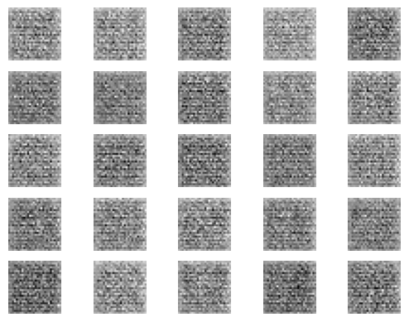
RESULTS
By harnessing the power of deep learning and convolutional neural networks, we have provided a valuable tool for artists, designers, researchers, and companies seeking high-quality and diverse animal images for various applications.
https://github.com/DKiruthikalakshmi/TNSDC-Generative-AI
3/21/2024 Annual Review
10

